Slide 1
Apple Inc. Stock Prediction
William Justice
12/21/2020

Slide 2
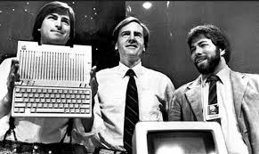
Brief Introduction to Apple Inc.
Founded in 1976 by Steve Jobs, Steve Wozniak, and Ronald Wayne
Current CEO is Tim Cook
Headquarters in Cupertino California.
Current Net worth of two trillion USD.
Specialized in distribution of computer software and consumer electronics.

Slide 3
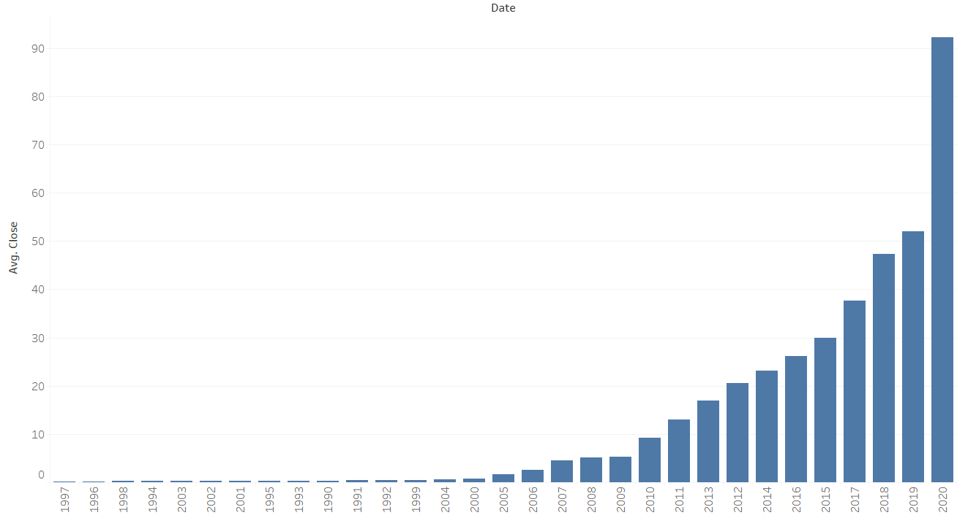
History of Apple Success
Apple officially became public in 1980
Today Apple Inc.’s stock value hovers just above one hundred dollars.
Apple Stock has been as high as $412 which was just recently in July of 2020.

Slide 4
Linear Regression Model Selection
Models the relationship between two variables by fitting a linear equation to observed data.
Formula : y = c + b*x
Requires a linear relationship
A linear regression model is based off the historical data that makes up the slope of a line
There most definitely is a linear relationship between time and closing costs

Slide 5
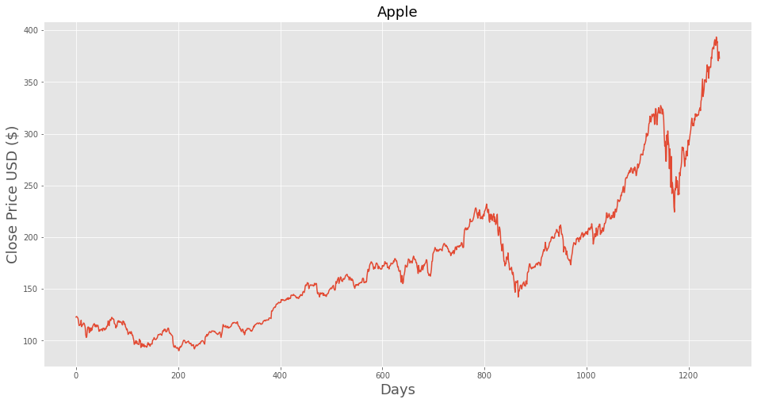
Linear Relationship of AAPL Stock Price

Slide 6
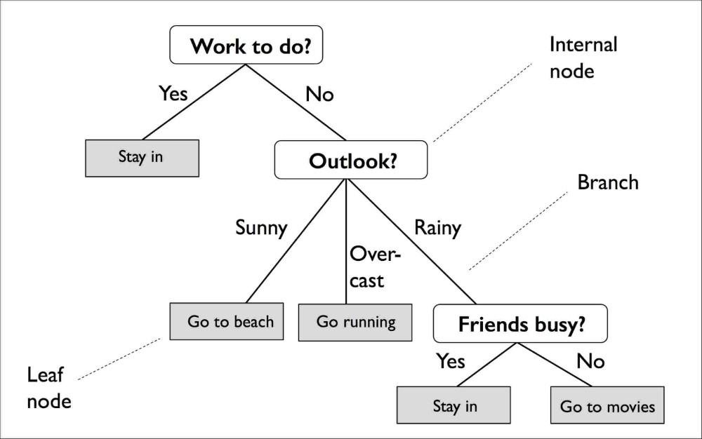
Decision Tree Model Selection
The decision tree is known as a broad brush that is able to be applied to many analytic challenges.
Decision trees can deal with complex data, which is part of what makes them useful.
It could be said that the decision tree model is the jack of all trades but the master of none.
Simplistic way of subsetting data with nodes and branches.

Slide 7
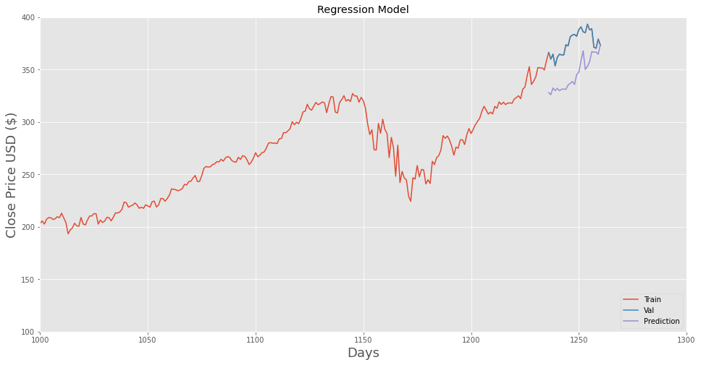
Linear Regression Model Results
The results of the linear regression model were not what was anticipated.
Results were anticipated to be better than they were based on how well the data was suited towards the regression data requirements.
Although this appears to be close, better performance was observed with the decision tree model.

Slide 8
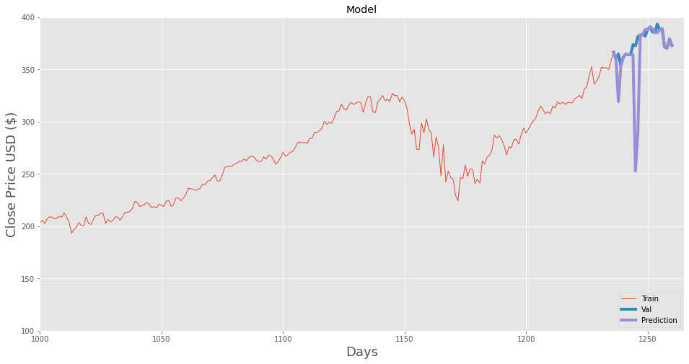
Decision tree model results
It can be observed that the decision tree model does follow the actual data much more closely.
Unfortunately there is some substantial predictions that heavily skew performance.
These two days of drastic performance drop do follow the overall trend of the historic data. Look closely at the general rise and fall that is mimicked.

Slide 9
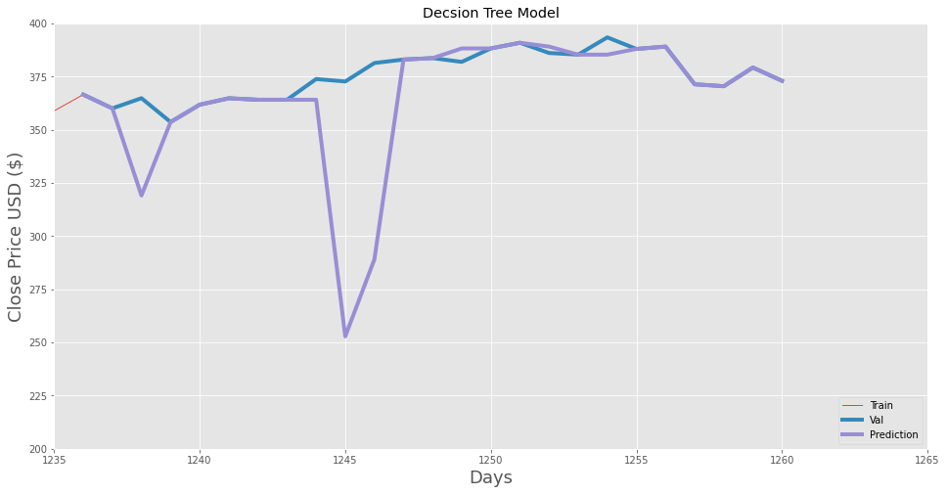
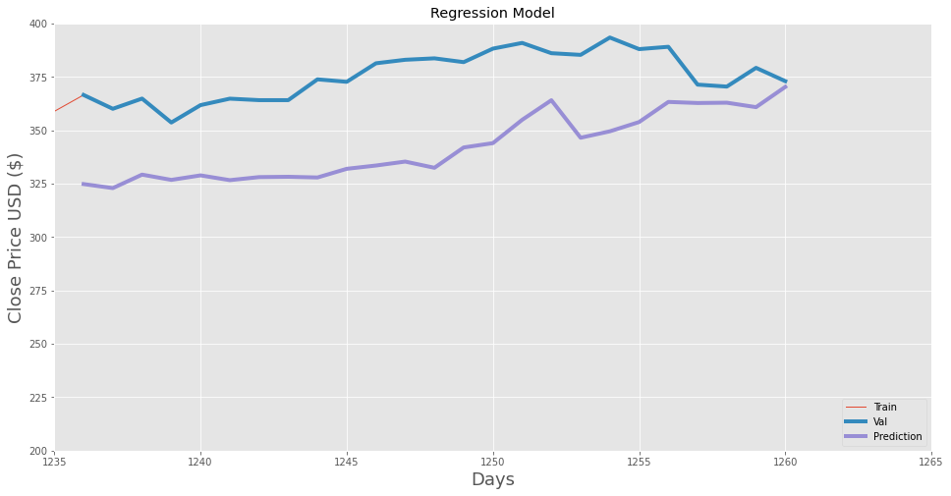
Model comparisons
It can be observed that neither model is trustworthy enough to put any money behind.
Although since comparison is deemed necessary by the project, the decision tree model is more accurate based on its ability to closely follow the actual data most of the time.

